Slide 1
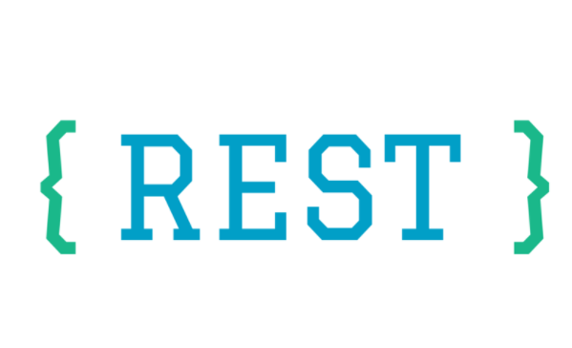

Slide 2
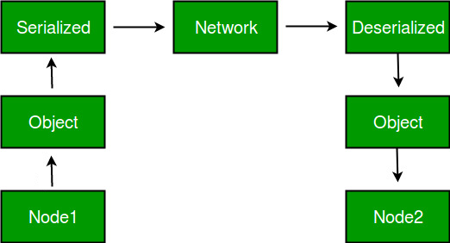
RPC
RPC: Remote Procedure Call / RMI: Remote Method Invocation
Client-Server
Distributed systems over a shared network
Operating system processes
Method signatures
Data types (“serializable” objects, marshalling)
Same programming language

Slide 3
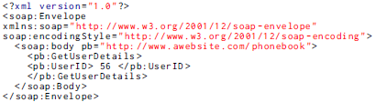
SOAP
SOAP: Simple Object Access Protocol
Decentralized, distributed environment
Information exchanged over several protocols (SMTP, HTTP…)
Independent of programming and implementation details
XML to define an extensible, structured messaging framework

Slide 4
REST
REST: Representational State Transfer
Describes how resources on web servers should be exposed via the HTTP protocol
Resource identification through a uniform resource identifier (URI)
Resources are manipulated using a fixed set of CRUD operations (actions) with HTTP methods
POST - Create a new resource
GET - Read the current state of a resource
PUT – Update a resource
DELETE - Delete a resource
Messages are self descriptive and simple, e.g.
http://www.mysite.com/phonebook/users/56

Slide 5
SOAP versus REST
As SOAP is an official protocol, it comes with strict rules and advanced security features such as built-in ACID compliance and authorization.
SOAP has higher complexity, and requires more bandwidth and resources, which can lead to slower page load times.
REST consumes fewer resources than SOAP because its messages are typically smaller.
REST was created to address the problems of SOAP. Therefore it has a more flexible architecture. It consists of guidelines and lets developers implement them in their own way.
It allows different messaging formats, such as HTML, CSV, JSON, XML, and plain text, while SOAP only allows XML.
REST is also a more lightweight architecture, so RESTful web services have a better performance.
Because of that, it has become incredibly popular in the mobile era where even a few seconds matter a lot (both in page load time and revenue).
Notes:
ACID (Atomicity, Consistency, Isolation, Durability) is a set of properties of database transactions intended to guarantee validity even in the event of errors

Slide 6
SOAP versus REST
SOAP | REST
Function-driven (data available as services, e.g.: “getUser”) | Data-driven (data available as resources, e.g. “user”)
API calls cannot be cached | API calls can be cached
Requires more bandwidth and computing power | Requires fewer computing resources
Only XML | Plain text, HTML, XML, JSON, CSV…
HTTP, SMTP, UDP, TCP | HTTP
High security, standardized, extensible | Faster, flexible, scalable
High-security apps, complex transactions, financial services, payment gateways, legacy systems | Public data APIs, mobile services, social networks
Example: PayPal | Example: Twitter
Notes:
https://raygun.com/blog/soap-vs-rest-vs-json/

Slide 7
REST properties
Platform-independency: no need to worry whether the underlining O.S. is Windows, Linux, Mac, Solaris…
Language-independency: REST can be implemented in any language (Java, PHP, C#, Python, JavaScript…)
Standards-based: REST runs on top of HTTP, and can easily be used in the presence of firewalls.
Lightweight: it offers no built-in features like security, session management or encryption. However, these can be added by building on top of HTTP.

Slide 8
REST properties
Simplicity: REST helps you organise even a very complex application into simple resources.
Portability: REST makes it easy for new clients to use your application (mobile devices, wearable devices, servers…)
Scalability: REST helps reduce client/server coupling. It is easy to evolve a REST interface over time without breaking existing clients.

Slide 9
REST architectural style constraints
Roy Fielding’s Doctoral Dissertation http://www.ics.uci.edu/~fielding/pubs/dissertation/rest_arch_style.htm
Complying with these 6 constraints will enable any distributed hypermedia system to have desirable properties such as scalability, simplicity and portability.
NOTE: The only optional constraint of REST architecture is code on demand (#6).
If a web service violates any other constraint, it cannot strictly be referred to as RESTful.

Slide 10
REST architectural style constraints
Uniform Interface
defines the interface between clients and servers
simplifies and decouples the architecture, which enables each part to evolve independently
Resource-Based
Individual resources are identified in requests using URIs as resource identifiers. The resources themselves are conceptually separate from the representations that are returned to the client. For example, the server does not send its database record, but rather, some HTML, XML or JSON that represents some database records.

Slide 11
REST architectural style constraints
Manipulation of Resources Through Representations
When a client holds a representation of a resource, including any metadata attached, it has enough information to modify or delete the resource on the server, provided it has permission to do so.
Self-descriptive Messages
Each message includes enough information to describe how to process the message. For example, which parser to invoke may be specified by an Internet media type (previously known as a MIME type).
e.g. Accept Header, Content-Type Header = application/json

Slide 12
REST architectural style constraints
Hypermedia as the Engine of Application State (HATEOAS)
Clients deliver state via body contents, query-string parameters, request headers and the requested URI (the resource name).
Services deliver state to clients via body content, response codes, and response headers. This is technically referred-to as hypermedia.
HATEOS also means that, where necessary, links are contained in the returned body (or headers) to supply the URI for retrieval of the object itself or related objects (hyperlinks within hypertext).

Slide 13
REST architectural style constraints
Stateless
The necessary information to handle a request is contained within the request itself, whether as part of the URI, query-string parameters, body, or headers.
The URI uniquely identifies the resource and the body contains the state (or state change) of that resource. After the server does its processing, the appropriate state is communicated back to the client via headers, status and response body.
In REST, every HTTP request occurs in complete isolation, if something is repeatedly required (e.g. authentication tokens), the client must send it again across multiple requests.
Statelessness enables greater scalability since the server does not have to maintain or communicate sessions.

Slide 14
REST architectural style constraints
Cacheable
As on the World Wide Web, clients can cache responses. Responses must therefore, implicitly or explicitly, define themselves as cacheable, or not, to prevent clients reusing stale or inappropriate data in response to further requests.
Well-managed caching partially or completely eliminates some client–server interactions, further improving scalability and performance.
e.g. Expires Header

Slide 15
REST architectural style constraints
Client-Server
The uniform interface separates clients from servers. This separation of concerns means that, for example, clients are not concerned with data storage, which remains internal to each server, so that the portability of client code is improved.
Servers are not concerned with the user interface or user state, so that servers can be simpler and more scalable.
Servers and clients may also be replaced and developed independently, as long as the interface is not altered.

Slide 16
REST architectural style constraints
Layered System
A client cannot ordinarily tell whether it is connected directly to the end server, or to an intermediary along the way.
Intermediary servers may improve system scalability by facilitating load-balancing and shared caches.
Layers may also enforce security policies.
A layered system also allows for hierarchical components that cannot "see" beyond the immediate layer with which they are interacting.
Every layer should have a single high-level purpose, e.g. data access, business logic, and presentation.

Slide 17
REST architectural style constraints
Code on Demand (optional)
When necessary, the response can contain executable code.
Servers are able to temporarily extend or customize the client functionality by transferring logic that the client can execute.
Examples of this may include compiled components such as Java applets, or client-side scrips: JavaScript.

Slide 18
URI – Uniform Resource Identifier
Everything that should be identifiable should get an ID. On the Web, there is a unified concept for IDs: The URI.
URIs make up a global namespace, and using URIs to identify your key resources means they get a unique, global ID.
These identify all of the “high-level” resources that your application provides, whether they represent:
individual items
collections of items
computation results…

Slide 19
REST conventions
The main benefit of a consistent naming scheme is that it follows a predictable structure, therefore it can be understood by anybody
http://localhost/books/
http://localhost/books/ISBN-0011
http://localhost/books/ISBN-0011/authors
http://localhost/classes
http://localhost/classes/dt228-4
http://localhost/classes/dt228-4/students
As you traverse the path from more generic to more specific, you are navigating the data

Slide 20
REST conventions
www.mysite.com
retrieve a list of users: GET www.mysite.com/users
retrieve user 56: GET www.mysite.com/users/56
create a new user: POST www.mysite.com/users
update user 56: PUT www.mysite.com/users/56
remove user 56: DELETE www.mysite.com/users/56
www.mysite.com/users
instead of
www.mysite.com/overview.php?type=users&list=all
=> URL routing

Slide 21
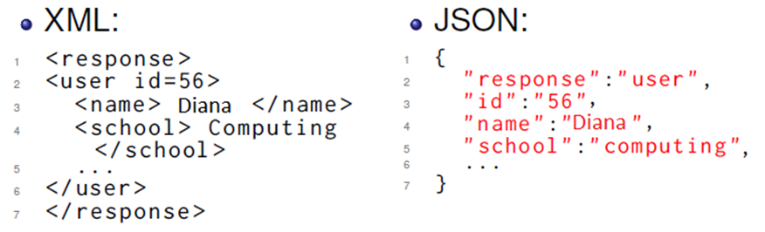
Example
Request: GET www.mysite.com/users/56
Just a URI sent to the server by HTTP method GET
Response:
raw result data
not embedded inside anything (e.g. like a SOAP response envelope)
ready to use

Slide 22
REST GET request

Slide 23
REST POST request
When you create a new resource with POST, the server decides the URI.

Slide 24
REST PUT request
A PUT request must send the new complete representation of the resource to the server.

Slide 25
REST DELETE request

Slide 26
Safety and Idempotence
GET requests are safe (ignoring or repeating them has no consequences)
PUT and DELETE methods are idempotent (can be repeated without side-effects)
POST is unsafe and non-idempotent => handle with care
“Are you sure you want to post this form again?”
“Do you really want to purchase this item again?”

Slide 27
Representations
It is common to have multiple representations of the same data
The client can ask for a representation in a particular format: CSV, XML, JSON…
An AJAX application may want JSON
A Ruby application my want XML…
HTTP Headers or the URI can specify the desired format

Slide 28
Example: Google Maps Distance Matrix API
Google Maps Distance Matrix API (JSON or XML)
https://developers.google.com/maps/documentation/distance-matrix/start
Request:
https://maps.googleapis.com/maps/api/distancematrix/outputFormat?parameters
https://maps.googleapis.com/maps/api/distancematrix/json?origins=Seattle&destinations=San+Francisco&key=YOUR_API_KEY
Defaults: mode = driving. Distance value: meters, duration: seconds
NOT JUST A DIV WITH A GOOGLE MAP ON YOUR PAGE!
A GET REQUEST WITH PARAMETERS THAT RETURNS JSON OR XML!

Slide 29
RESPONSE:
{
"destination_addresses" : [ "San Francisco, CA, USA" ],
"origin_addresses" : [ "Seattle, WA, USA" ],
"rows" : [
{
"elements" : [
{
"distance" : {
"text" : "1,300 km",
"value" : 1299875
},
"duration" : {
"text" : "12 hours 25 mins",
"value" : 44722
},
"status" : "OK"
}
]
}
],
"status" : "OK"
}

Slide 30
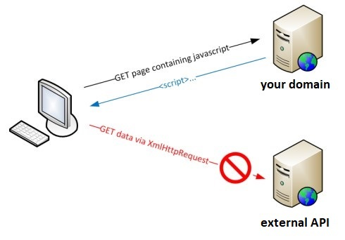
Requesting from the Client-Side
Due to browser security restrictions, most AJAX and Fetch requests are subject to the same-origin policy
the request cannot retrieve data from a different domain, subdomain, port, or protocol, unless the response includes the right CORS headers.

Slide 31
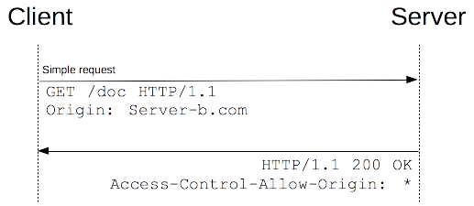
CORS
The CORS standard works by adding new HTTP headers that allow servers to describe the set of origins that are permitted to read that information using a web browser, e.g.
Access-Control-Allow-Origin: *
https://developer.mozilla.org/en-US/docs/Web/HTTP/CORS

Slide 32
Requesting from the Client-Side
For example, Google APIs support requests and responses using CORS
However, some firewalls will strip the Access-Control-Allow-Origin header from the server’s response in a CORS scenario, and you may receive an error message on the browser’s console:
Access to XMLHttpRequest at (…)
from origin (…) has been blocked by CORS policy: No 'Access-Control-Allow-Origin' header is present on the requested resource.
So, you can use a proxy server to forward your request, and send you back the result in an acceptable format,
e.g. https://cors-anywhere.herokuapp.com/

Slide 33
Requesting from the Client-Side
Example: Google Maps Distance Matrix API
$.get("https://cors-anywhere.herokuapp.com/"+
"https://maps.googleapis.com/maps/api/distancematrix/json?origins=Seattle&destinations=San+Francisco&key="+YOUR_API_KEY, function(data){ // consume the response });
You’ll need to read the documentation for each specific API to determine how to format your query
Mind the daily request quota for free APIs
Notes:
Invocations of the XMLHttpRequest (client scripts) in a cross-site manner.

Slide 34
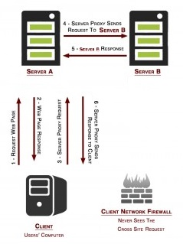
Requesting via the Server-Side
You can also forward the request to your own server and have a script request the API data, and send the result back to the client-side code;
This method does not trigger security settings in browsers or firewalls, and it is compatible across all browsers.
However, it may have implications on your own server’s load and scalability.

Slide 35
Some APIs
The Open Movie Database (JSON or XML)
http://www.omdbapi.com/
Spotify Web API (JSON)
https://developer.spotify.com/web-api/
AccuWeather Enterprise API (JSON)
http://apidev.accuweather.com/developers/
Wikipedia/Wikimedia (XML)
https://www.mediawiki.org/wiki/REST_API
Facebook Graph API (JSON)
https://developers.facebook.com/docs/graph-api/overview
Flickr (XML, JSON, SOAP, RPC)
https://www.flickr.com/services/api/
Zomato (JSON or XML)
https://developers.zomato.com/api

Slide 36
Questions?

